Slide 1
MyBank Banking application
Team: Wealth Warriors
Module: Insurance Application

Slide 2
Overview
Insurance module allows users to view all the available insurance in the bank .
It also allows the users to apply for insurance.
As well as search particular insurance by id.
And search available insurance based on the coverage amount.
And provide a user- friendly responsive user interface.

Slide 3
Requirement Analysis
User Authentication and Authorization
Financial Tools and Resources
Mobile Banking Support
Technologies used:
Frontend Technologies
Backend Technologies
Security Frameworks
DevOps Tools
Testing Frameworks

Slide 4
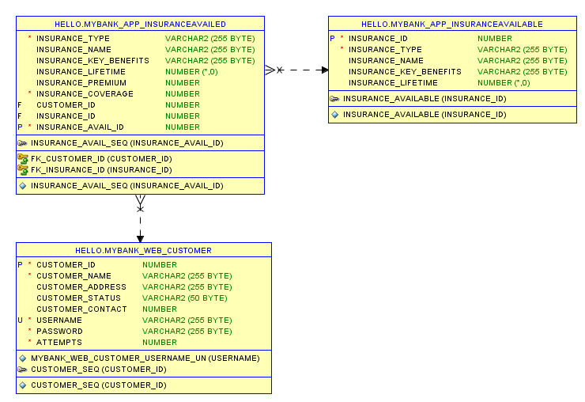
Database design

Slide 5
VIEW INSURANCE MODULE:
Upon the successful login, we provide a menu of insurance types.
View All Insurance type: Displays a list of all insurance types available in the database . It has attributes
INSURANCE_ID
INSURANCE_TYPE
INSURANCE_NAME
INSURANCE_KEY_BENEFITS
INSURANCE_LIFETIME

Slide 6
POST INSURANCE MODULE:
Upon the successful login, we provide a menu of insurance types.
Apply for Insurance : user applies for the insurance through the form. Below given are the attributes
INSURANCE_TYPE
INSURANCE_NAME
INSURANCE_KEY_BENEFITS
INSURANCE_LIFETIME
INSURANCE_PREMIUM
INSURANCE_COVERAGE
CUSTOMER_ID
INSURANCE_ID
INSURANCE_AVAIL_ID

Slide 7
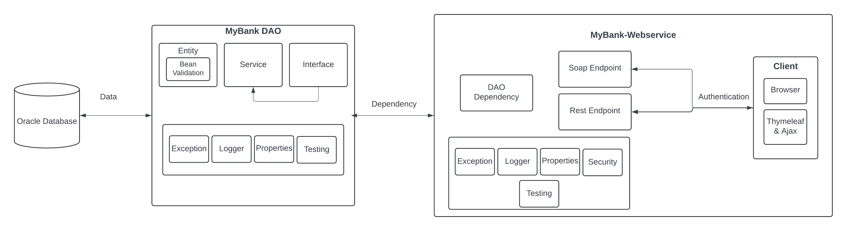
Project Structure:

Slide 8
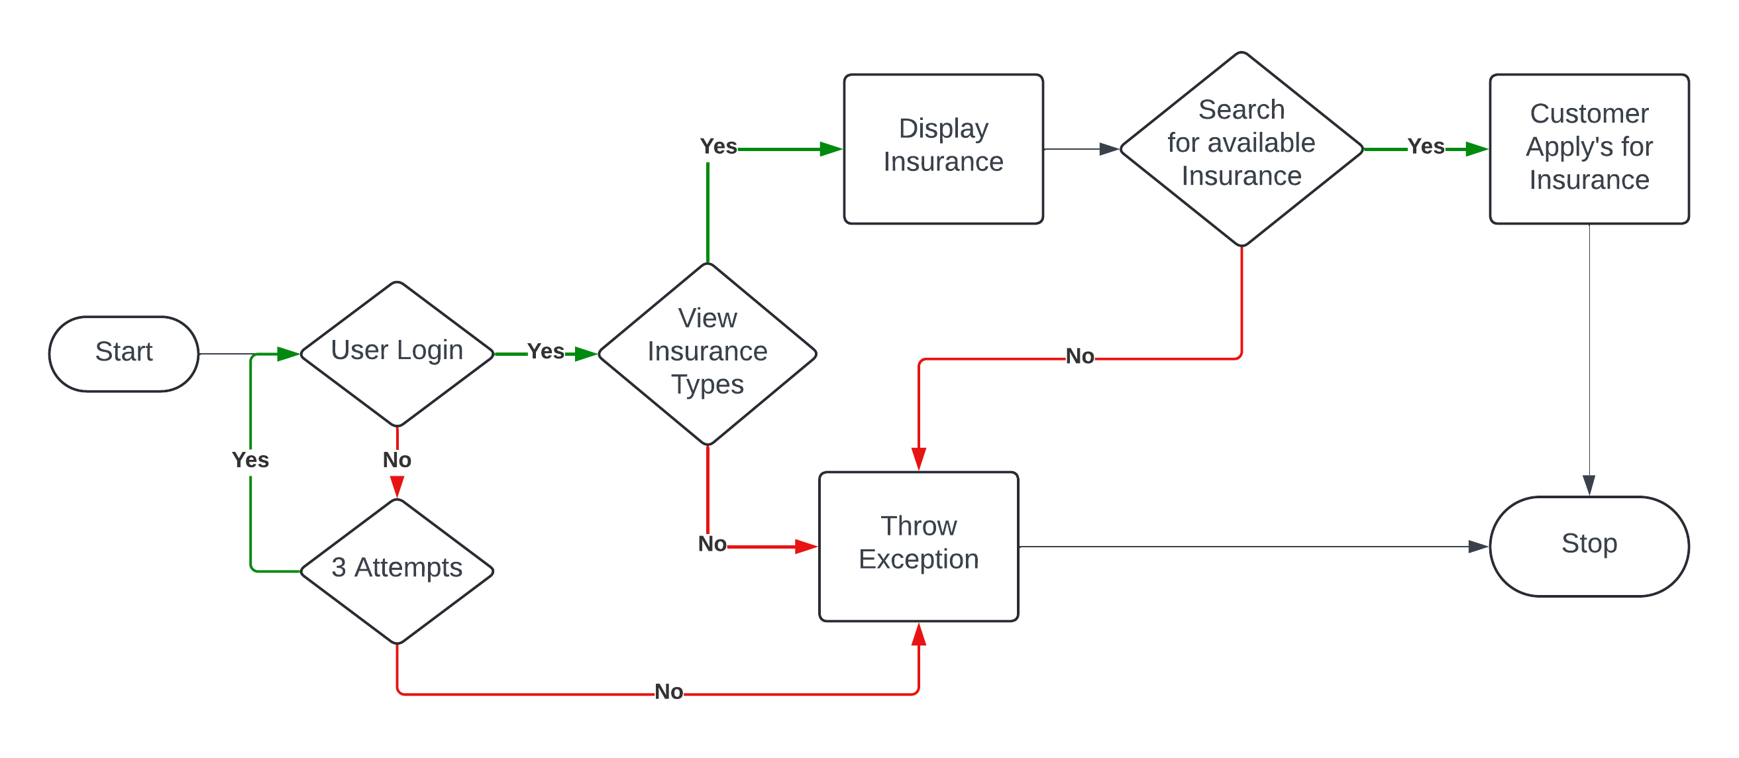
Data Flow Diagram

Slide 9
Links and Files
Git hub link- DLTE-Java-Full-Stack-ElroyMerwynMonis-2024/DLTE-MyBank-Project at master · elroy26/DLTE-Java-Full-Stack-ElroyMerwynMonis-2024 (github.com)
War file link- DLTE-Java-Full-Stack-ElroyMerwynMonis-2024/DLTE-MyBank-Project/MyBank-Insurance-WebService/target/webservice-0.0.1-SNAPSHOT.war at master · elroy26/DLTE-Java-Full-Stack-ElroyMerwynMonis-2024 (github.com)

Slide 10

Thankyou

